Slide 1


Autonomous Car
Reported by Chen Zhaobin
23rd,Nov.,2017
Notes:
Good evening ,everyone .Today it is my turn to give a wiki talk .My topic is about Autonomous Car .Two weeks ago ,Zehai gives a talk about bitcoin .Last week ,Shenlin gives another one about AlphaGo Zero .Those are very hot topics in recent years .So I want to follow this trend .And last week ,Fuqing asked a question about the self-driving and Zehai gave me a suggestion that I can consider it to be my topic of wiki talk this week. It was exactly what I was hoping for .And I have no idea about other topics .So it comes to be my final decision .I think the development of self-driving represents the development trend of modern industry and will be related to everyone in the future. So I hope my topic will raise your interests .My talk is maybe a brief introduction of popular science without too much details of technology.
Now let me begin my talk .

Slide 2

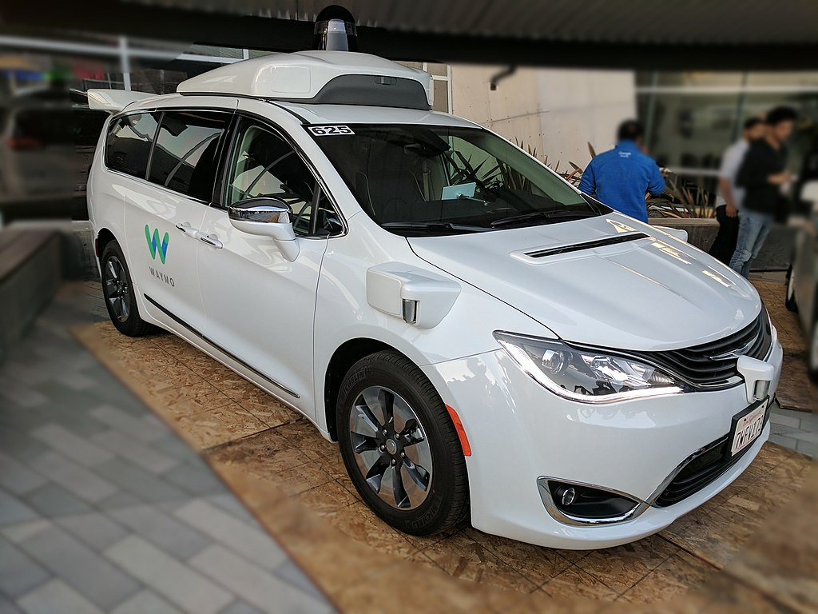
Autonomous Car
CONTENTS
Brief definition and history
How to work
Classification
Potential advantages, obstacles and disadvantages
Waymo Pacifica driverless minivan
PAGE 1
Notes:
This talk is made up of four parts .First is the brief definition([ˌdefɪˈnɪʃn]) and the history of Autonomous Car .Next is how an Autonomous Car works .Third part is a classification ranging from fully manual([ˈmænjuəl]) to fully automated systems .Last part is about potential advantages, obstacles([ˈɒbstəkl]) and disadvantages of the development of Autonomous Car.

Slide 3
Autonomous Car
01
Brief Definition and History
PAGE 2
Notes:
First part: the brief definition and the history of Autonomous Car.

Slide 4
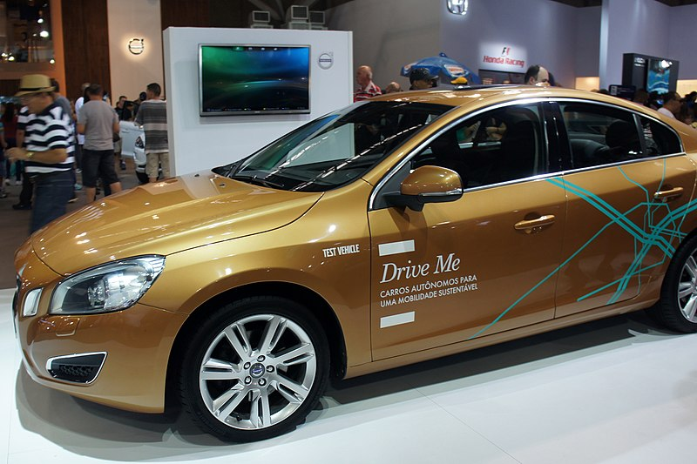
Autonomous Car
Brief Definition
An autonomous car (also known as a driverless car, self-driving car, robotic car, autos) is a vehicle that is capable of sensing its environment and navigating without human input.
The aim of the Volvo Drive Me project, which is using Volvo S60 test vehicles, is to develop SAE level 4 cars.
PAGE 3
Notes:
So what is an Autonomous Car ? There is a brief definition. An autonomous car (also known as a driverless([d'raɪvərles]) car, self-driving car, robotic car, autos) is a vehicle that is capable([ˈkeɪpəbl]) of sensing its environment and navigating without human input.

Slide 5
Autonomous Car
History
1920s:experiments about autonomous car
1950s:promising trials
1980s:the first truly autonomous prototype cars
Since then, numerous companies and research organizations have developed prototypes
2015:the testing of autonomous cars on public roads was allowed in serval states of the U.S.A.
2017:The Audi A8 was claimed to be the first production car to reach level 3 autonomous driving and Audi would be the first manufacturer to use laser scanners in addition to cameras and ultrasonic([声] 超声的[ˌʌltrəˈsɒnɪk]) sensors for their system.
PAGE 4
Notes:
Next ,let us look at the history of Autonomous Car.Experiments have been conducted(vt.实施;执行;) on automating driving since at least the 1920s.And the promising trials([ˈtraɪəl]) took place in the 1950s. The first truly autonomous prototype([prəʊtətaɪp] n.原型) cars appeared in the 1980s. Since then, numerous([ˈnju:mərəs]数不清的; 很多的) companies and research organizations have developed prototypes. In 2015, serveral states of U.S.A allowed the testing of autonomous cars on public roads .In 2017,The Audi A8 was claimed to be the first production car to reach level 3 autonomous driving and Audi would be the first manufacturer([ˌmænjuˈfæktʃərə(r)]) to use laser scanners in addition to cameras and ultrasonic([ˌʌltrəˈsɒnɪk]) sensors for their system

Slide 6
Autonomous Car
02
How to Work
PAGE 5
Notes:
Second part:How can an Autonomous Car work.

Slide 7
Autonomous Car
How to work
Autonomous cars use a variety of techniques to detect their surroundings. These techniques includes:
Camera
Radar
Laser light
GPS(Global Positioning System)
Odometry ( [‘ɒdɒmɪtrɪ]里程计，测程法)
Computer vision
PAGE 6
Notes:
As mentioned above ,an Autonomous Car can navigate([ˈnævɪgeɪt]) without human input .But how can it reach this goal .First, Autonomous cars use a variety of techniques to detect their surroundings. These techniques includes :Radar ,Laser light ,GPS(Global Positioning System) , Odometry ( ['ɒdɒmɪtrɪ]里程计, 测程法) ,Computer vision([ˈvɪʒn]) and so on. Some of them are common in manual car while others are newly added.

Slide 8
Autonomous Car
How to work
Then the advanced control systems interpret sensory information to identify appropriate navigation paths, as well as obstacles and relevant signage. Autonomous cars must have control systems that are capable of analyzing sensory data to distinguish between different cars on the road.
PAGE 7
Notes:
Then the advanced control systems interpret sensory([ˈsensəri]) information to identify appropriate navigation paths, as well as obstacles and relevant([ˈreləvənt]) signage([ˈsaɪnɪdʒ]). Autonomous cars must have control systems that are capable of analyzing sensory data to distinguish between different cars on the road.

Slide 9
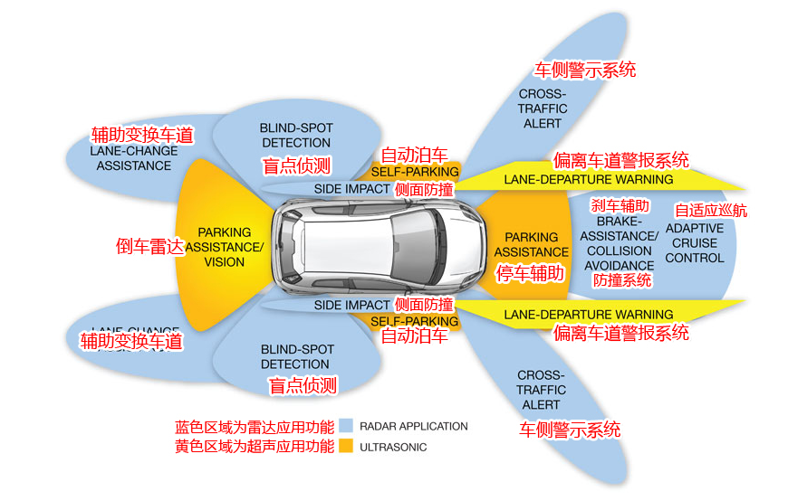
Autonomous Car
How to work
The wiki does not gave some details of the technology used for Autonomous Car. It only mentions algorithms called Bayesian Simultaneous localization and mapping (SLAM) (即时定位与地图构建), which fuse data from multiple sensors and an off-line map into current location estimates and map updates.
PAGE 8
Notes:
The wiki does not gave some details of the technology used for Autonomous Car. It only mentions algorithms([ˈælgərɪðəm]) called Bayesian Simultaneous(同时的[ˌsɪmlˈteɪniəs]) localization([ˌləʊkəlaɪ'zeɪʃn]) and mapping (SLAM) (即时定位与地图构建), which fuse([fju:z]融合) data from multiple sensors and an off-line(离线的) map into current location estimates(['estɪməts]估计，估算) and map updates.The picture below is what I found in another website. From it, you can see that Autonomous Car needs to be equipped with quite a lot of techniques and make sure they can cooperate with each other to reach its goals. But I do not know exactly the details of them, so I would like to turn to the next page.

Slide 10
Autonomous Car
03
Classification
PAGE 9
Notes:
Third part is a classification to measure the degree of automated(['ɔ:təʊmeɪtɪd]) in a car.

Slide 11
Autonomous Car
Classification
A classification system based on six different levels (ranging from fully manual to fully automated systems) was published in 2014 by SAE International, an automotive standardization body, as J3016, Taxonomy and Definitions for Terms Related to On-Road Motor Vehicle Automated Driving Systems.
This classification system is based on the amount of driver intervention required, rather than the vehicle capabilities.
In the United States in 2016, the National Highway Traffic Safety Administration (NHTSA) abandoned(放弃) his own classification system in favor of the SAE standard.
Also in 2016, SAE updated its classification, called J3016_201609.
PAGE 10
Notes:
A classification system based on six different levels (ranging from fully manual to fully automated systems) was published in 2014 by SAE International, an automotive([ˌɔ:təˈməʊtɪv] 汽车的;) standardization([ˌstændədaɪ'zeɪʃn]) body, as J3016, Taxonomy([tækˈsɒnəmi]) and Definitions for Terms Related to On-Road Motor Vehicle Automated Driving Systems.
This classification system is based on the amount of driver intervention([ˌɪntə'venʃn]) required, rather than the vehicle capabilities([ˌkeɪpəˈbɪləti]).
Then in the United States in 2016, the National Highway Traffic Safety Administration (NHTSA) abandoned(放弃) his own classification([ˌklæsɪfɪˈkeɪʃn]) system in favor of the SAE standard.
Also in 2016, SAE updated its classification, called J3016_201609.

Slide 12
Autonomous Car
Classification
Level 0: Automated system issues warnings and may momentarily intervene but has no sustained vehicle control.
Level 1 (”hands on”): Driver and automated system shares control over the vehicle. The driver must be ready to retake full control at any time.
Level 2 (”hands off”): The automated system takes full control of the vehicle (accelerating, braking, and steering(引导; 驾驶; 操纵，控制)). The driver must monitor the driving and be prepared to immediately intervene at any time if the automated system fails to respond properly.
PAGE 11
Notes:
Now show you the details of the classification
Level 0: Automated system issues([ˈɪʃu:]) warnings and may momentarily([ˈməʊməntrəli]) intervene([ˌɪntəˈvi:n] 阻碍; 出面; 插嘴) but has no sustained([səs'teɪnd]) vehicle control.
Level 1 (”hands on”): Driver and automated system shares control over the vehicle. The driver must be ready to retake full control at any time. An example would be Adaptive([əˈdæptɪv]适应的) Cruise([kru:z]) Control (ACC)(自适应巡航控制) where the driver controls steering([stɪə(r)]) and the automated system controls speed.kk Using Parking Assistance(停车辅助系统), steering is automated while speed is manual.
Level 2 (”hands off”): The automated system takes full control of the vehicle (accelerating([əkˈseləreɪt]), braking([breɪk]), and steering(引导; 驾驶; 操纵，控制)). The driver must monitor the driving and be prepared to immediately intervene at any time if the automated system fails to respond properly. The shorthand ”hands off” is not meant to be taken literally([ˈlɪtərəli])(确实地，真正地).

Slide 13
Autonomous Car
Classification
Level 3 (”eyes off”): The driver can safely turn their attention away from the driving tasks, e.g. the driver can text or watch a movie. The vehicle will handle situations that call for an immediate response, like emergency braking. The driver must still be prepared to intervene within some limited time, specified(指定;) by the manufacturer(制造商), when called upon(要求, 用来) by the vehicle to do so.
Level 4 (”mind off”): As level 3, but no driver attention is ever required for safety, i.e. the driver may safely go to sleep or leave the driver's seat. Self driving is surported only in limited areas (geofenced(地理围栏)) or under special circumstances, like traffic jams. Outside of these areas or circumstances, the vehicle must be able to safely abort(使中止) the trip, i.e. park the car, if the driver does not retake control.
Level 5 (”steering wheel optional”): No human intervention is required. An example would be a robotic taxi.
PAGE 12
Notes:
Level 3 (”eyes off”): The driver can safely turn their attention away from the driving tasks, e.g. the driver can text or watch a movie. The vehicle will handle situations that call for an immediate response, like emergency([iˈmɜ:dʒənsi]) braking. The driver must still be prepared to intervene within some limited time, specified([ˈspesɪfaɪ]指定;) by the manufacturer([ˌmænjuˈfæktʃərə(r)]制造商), when called (要求, 用来) by the vehicle to do so. In 2017 the Audi A8 Luxury([ˈlʌkʃəri]) Sedan([sɪˈdæn]) was the first commercial car to claim to be able to do level 3 self driving. The car has a so called Traffic Jam Pilot. When a upon([əˈpɒn]) activated([ˈæktɪveɪt]) by the human driver the car takes full control of all aspects of driving in slow-moving traffic at up to 60 kilometers per hour. The function only works on highways with a physical barrier separating oncoming traffic.
Level 4 (”mind off”): As level 3, but no driver attention is ever required for safety, i.e. the driver may safely go to sleep or leave the driver's seat. Self driving is surported only in limited areas (geofenced(地理围栏)) or under special circumstances([ˈsɜ:kəmstəns]), like traffic jams. Outside of these areas or circumstances, the vehicle must be able to safely abort(使中止) the trip, i.e. park the car, if the driver does not retake control.
Level 5 (”steering wheel optional”): No human intervention is required. An example would be a robotic taxi.

Slide 14
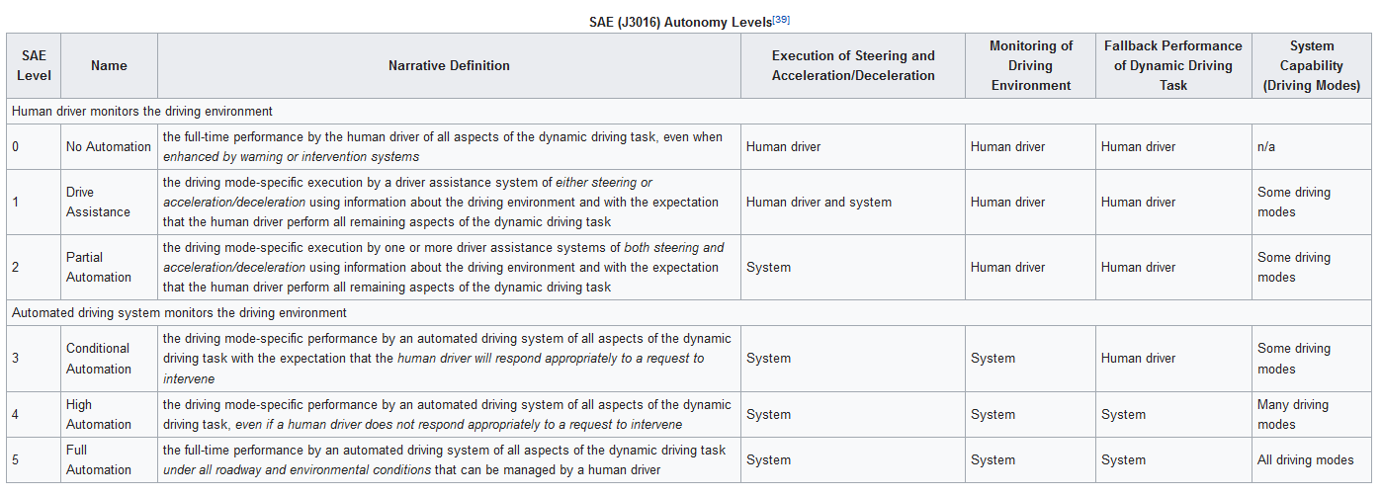
Autonomous Car
Classification
PAGE 13
Notes:
Here is a table from wiki to show the classification more clearly. We can distinguish between different levels through four aspects. They are Execution([ˌeksɪˈkju:ʃn]) of Steering and Acceleration/Deceleration([ˌdi:selə'reɪʃn]), Monitoring of Driving Environment, Fallback([ˈfɔ:lbæk] 可依靠的东西) Performance of Dynamic([daɪˈnæmɪk]) Driving Task and System Capability (Driving Modes).
We can see from the table that the car at least need to be always monitored by human drivers from level0 to level2,while Automated driving system will take the place of human to monitor the driving environment from level3-5.

Slide 15
Autonomous Car
04
Potential Advantages, Obstacles and Disadvantages
PAGE 14
Notes:
Now comes the last part .Let’s look at the potential Advantages, Obstacles([ˈɒbstəkl]) and Disadvantages of Autonomous Car.

Slide 16
Autonomous Car
Potential advantages
Safety : Reduce traffic collisions caused by human errors.
Welfare : Relieve travelers from driving and navigation chores.
Traffic : Decrease the need for safety gaps to bring to raise higher speed limits, make smoother rides and increase roadway capacity and minimize traffic congestion
Costs : Reduce the costs of vehicle insurance and lead to better fuel efficiency
Others : Reduce the need for parking space. Reduce the size of the automotive production industry . Free roadway space for other uses such as better support for pedestrians and cyclists . And so on.
PAGE 15
Notes:
The advantage is obvious([ˈɒbviəs]) .For safety , the application of Autonomous Car can reduce traffic collisions([kəˈlɪʒn]) caused by human errors.
For Welfare([ˈwelfeə(r) ]) : it can relieve travelers from driving and navigation chores([tʃɔ:(r)]).
For Traffic : it can decrease the need for safety gaps to raise higher speed limits, make smoother rides and increase roadway([ˈrəʊdweɪ] 车道; 路面) capacity([kəˈpæsəti] 容量;) and minimize([ˈmɪnɪmaɪz]) traffic congestion([kənˈdʒestʃən] 阻塞)
For Costs : it can Reduce the costs of vehicle insurance([ɪnˈʃʊərəns]) and lead to better fuel([ˈfju:əl]) efficiency([ɪˈfɪʃnsi])
And for others : it can reduce the need for parking space and Reduce the size of the automotive production industry .It can help free roadway space for other uses such as better support for pedestrians([pəˈdestriən]) and cyclists(['saɪklɪsts]). And there is lots of another advantages you can image .

Slide 17
Autonomous Car
Potential obstacles
disputes concerning liability
the time needed to turn the existing stock of vehicles from nonautonomous to autonomous
resistance by individuals to forfeit control of their cars
customer concern about the safety of driverless cars
the implementation of legal framework and establishment of government regulations for self-driving cars
ethical problems in situations where an autonomous car's software is forced during an unavoidable crash to choose
insufficient adaptation to gestures and non-verbal cues by police and pedestrians
PAGE 16
Notes:
But as the complexity([kəmˈpleksəti]) of road environment ,quite a lot of factors need to be considered. So the development of Autonomous Car may face many obstacles([ˈɒbstəkl]). Some of them but not all are listed below:
Disputes([dɪˈspju:t]) concerning liability([ˌlaɪəˈbɪləti] 责任; 债务; 倾向; <口>妨碍)
the time needed to turn the existing stock of vehicles from nonautonomous to autonomous
resistance([rɪˈzɪstəns]) by individuals([ˌɪndɪˈvɪdʒuəl]) to forfeit([ˈfɔ:fɪt] 丧失，失去) control of their cars
customer concern about the safety of driverless cars
the implementation([ˌɪmplɪmen'teɪʃn] 贯彻; 成就) of legal framework and establishment of government regulations for self-driving cars
ethical( [ˈeθɪkl]) problems in situations where an autonomous car's software is forced during an unavoidable([ˌʌnəˈvɔɪdəbl]) crash to choose
insufficient([ˌɪnsəˈfɪʃnt]) adaptation to gestures and non-verbal([ˈvɜ:bl] 口头的;) cues([kju:] 线索; 暗示) by police and pedestrians([pəˈdestriən])

Slide 18
Autonomous Car
Potential disadvantages
The loss of driving-related jobs in the road transport industry
The loss of privacy and risks of automotive hacking
An incentive(动机) to live far away from cities , inducing(引起) more urban sprawl(蔓延), more fuel consumption and an increase in the carbon footprint of urban travel
And so on…
PAGE 17
Notes:
And science and technology is a double-edged sword([sɔ:d]). The development of Autonomous Car will cause something unexpected. For example ,the loss of driving-related jobs in the road transport industry ,the loss of privacy([ˈprɪvəsi]) and the risks of automotive hacking([hæk] 乱劈，乱砍) are what we do not want to face.
Also the Autonomous Car will bring an incentive(动机)( [ɪnˈsentɪv]) to live far away from cities , inducing([ɪnˈdju:s]引起) more urban([ˈɜ:bən]) sprawl([sprɔ:l]蔓延), more fuel([ˈfju:əl]) consumption and an increase in the carbon footprint of urban travel .This is against the principle of sustainable([səˈsteɪnəbl]) development.

Slide 19
THANK YOU
Notes:
Let’s all. Thank you!

